Slide 1
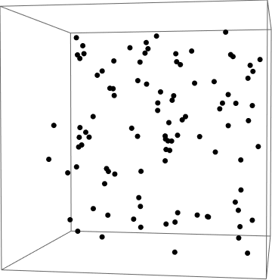


Micro to Macro Scaling in Energy and Economics
Suman Saurabh (saurabh@utexas.edu); Carey W. King (careyking@mail.utexas.edu); Larry Lake (larry_lake@mail.utexas.edu); Michael Marder (marder@chaos.utexas.edu); Eric Abelson (abelson@mail.utexas.edu); Louis Merceron (louis.merceron@ens-lyon.fr)

Slide 2




Agent-Based Model
ODE Model
Reproduce
Extract
Workers
Consume
Die
Reproduce
Non-Workers
Consume
HANDY *(Human and Nature Dynamics)
Die
convert
Nature
Regenerate
*Motesharrei, S., Rivas, J., Kalnay, E., 2014. Human and nature dynamics (HANDY): Modeling inequality and use of resources in the collapse or sustainability of societies. Ecological Economics 101, 90–102. https://doi.org/https://doi.org/10.1016/j.ecolecon.2014.02.014

Slide 3
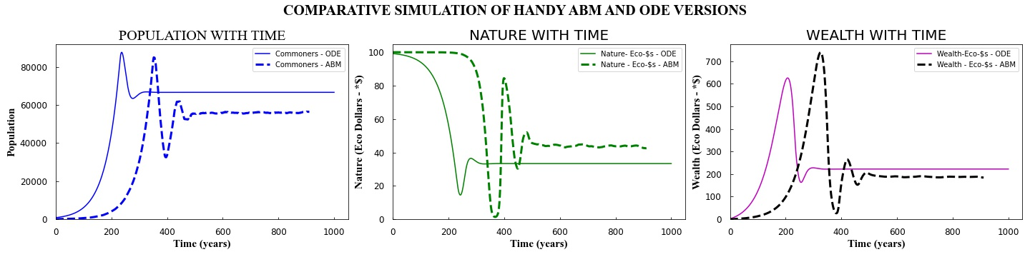

Slide 4
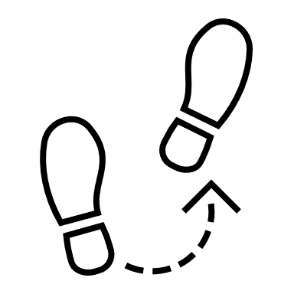

Random Movement
Intelligence

Slide 5
